Slide 1
COGNITIVE ROBOTICS PROJECT OBJECT GRASPING

Slide 2
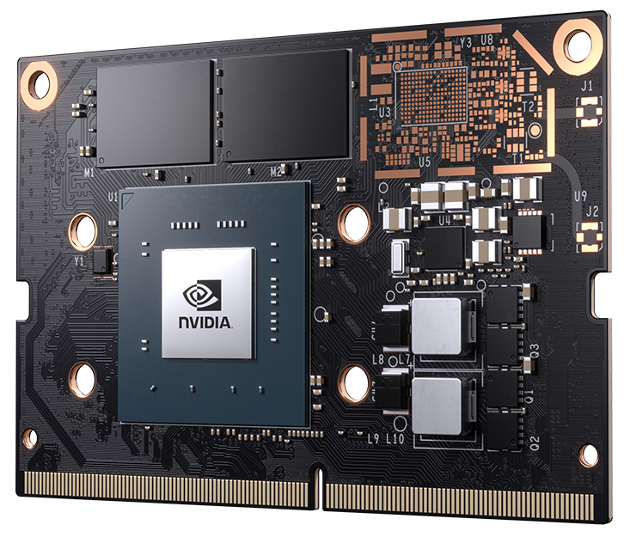
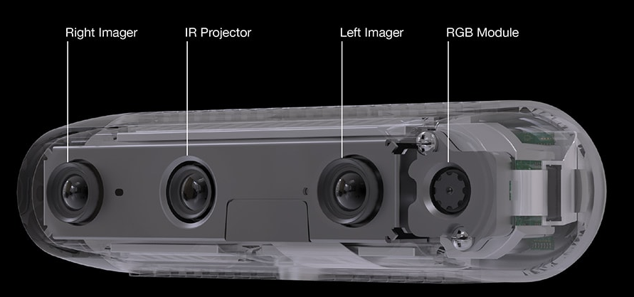
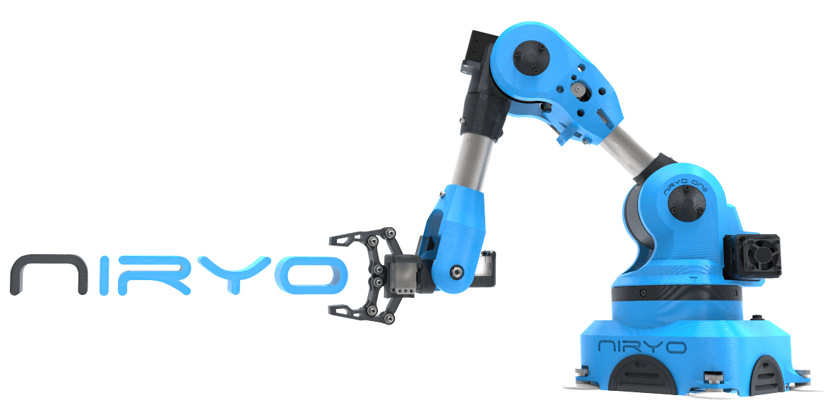

Project requirements
Intel® RealSense™ Depth Camera D435
NVIDIA® Jetson Nano™
Niryo One
Robot Operating System
Notes:
Introduction about components and speak about known issues.

Slide 3



Constraints
Camera
The only camera used is fixed on the end effector of the arm, making the environment more compact.
Boxes
Once the program has started, the boxes cannot be moved anymore.
Balls
You can add, remove and move the balls between each operating cycle.
Notes:
Constraits over the aim of the project

Slide 4
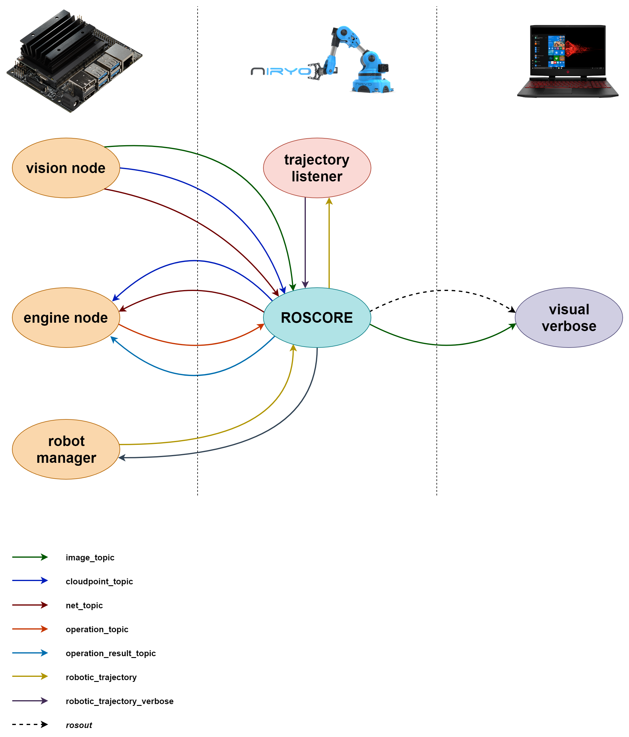
Software design

Slide 5
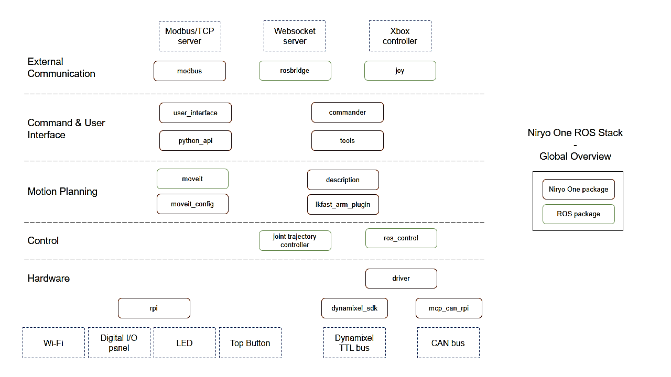
TRAJECTORY LISTENER NODE Moving Niryo One.
NIRYO ONE ROS STACK overview

Slide 6
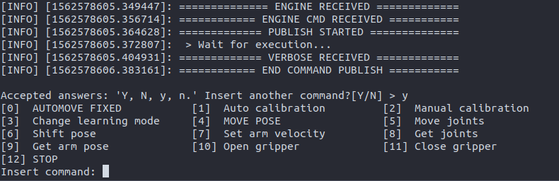
ROBOT MANAGER NODE Choose how to move.
ROBOT MANAGER command list
Notes:
Initialize system with calibration request
Command line interface with all the available commands of the robot
Request routines
Engine routines

Slide 7
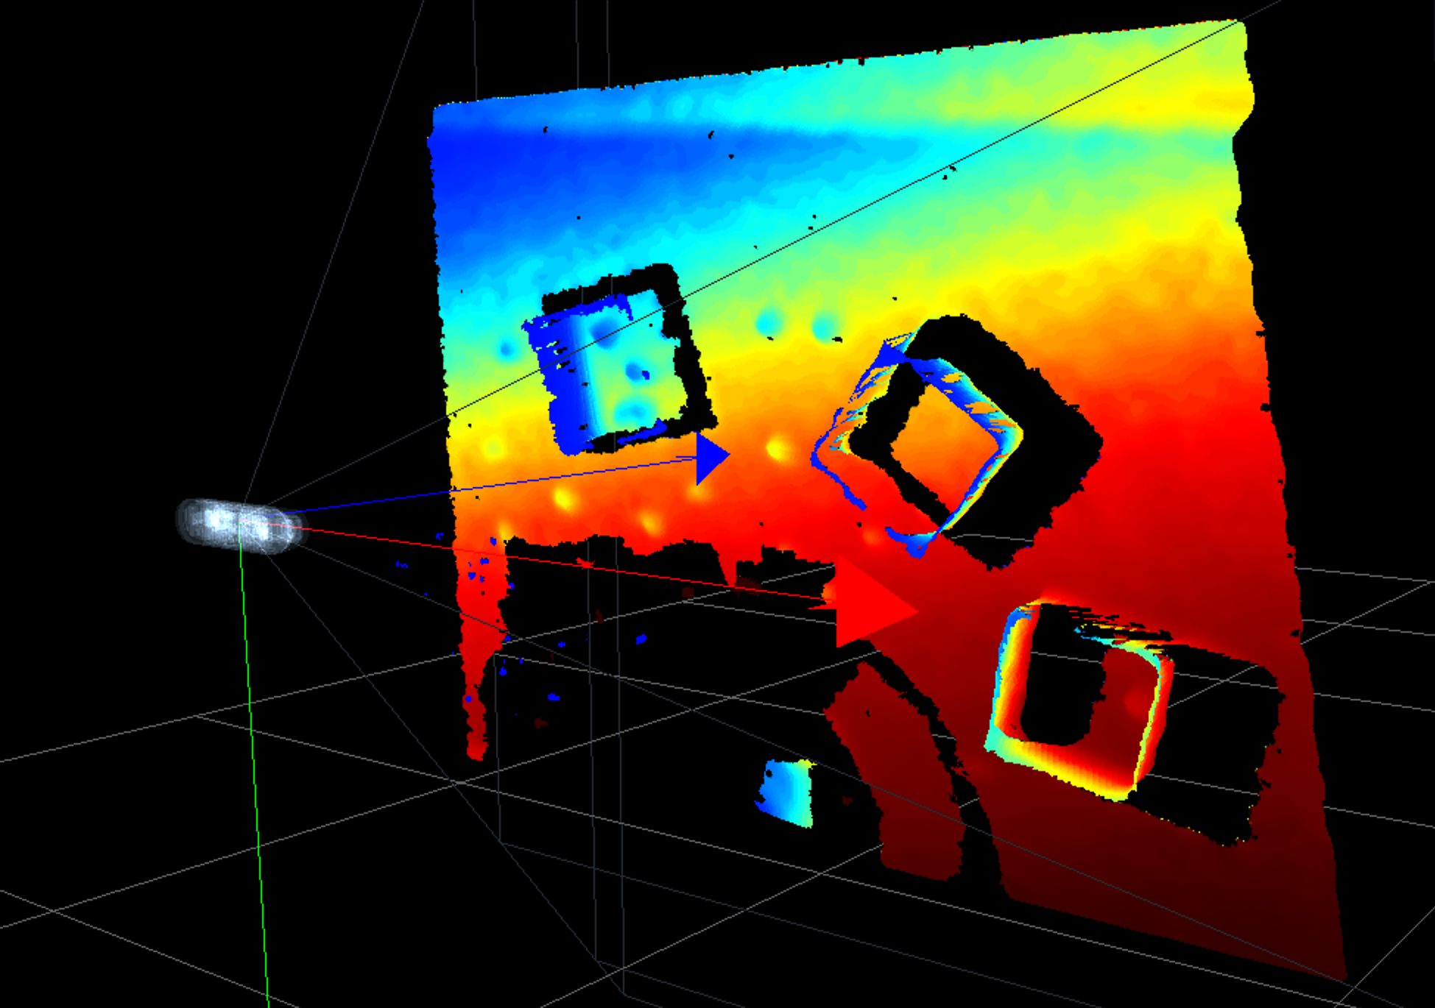
VISION NODE Look around.
Intel® RealSense™
Stereo Depth Technology
In a similar way to how human vision works, stereo depth is used to provide the distance of a precise point in the visual field.
RGB VIDEO and POINT CLOUD acquisition

Slide 8
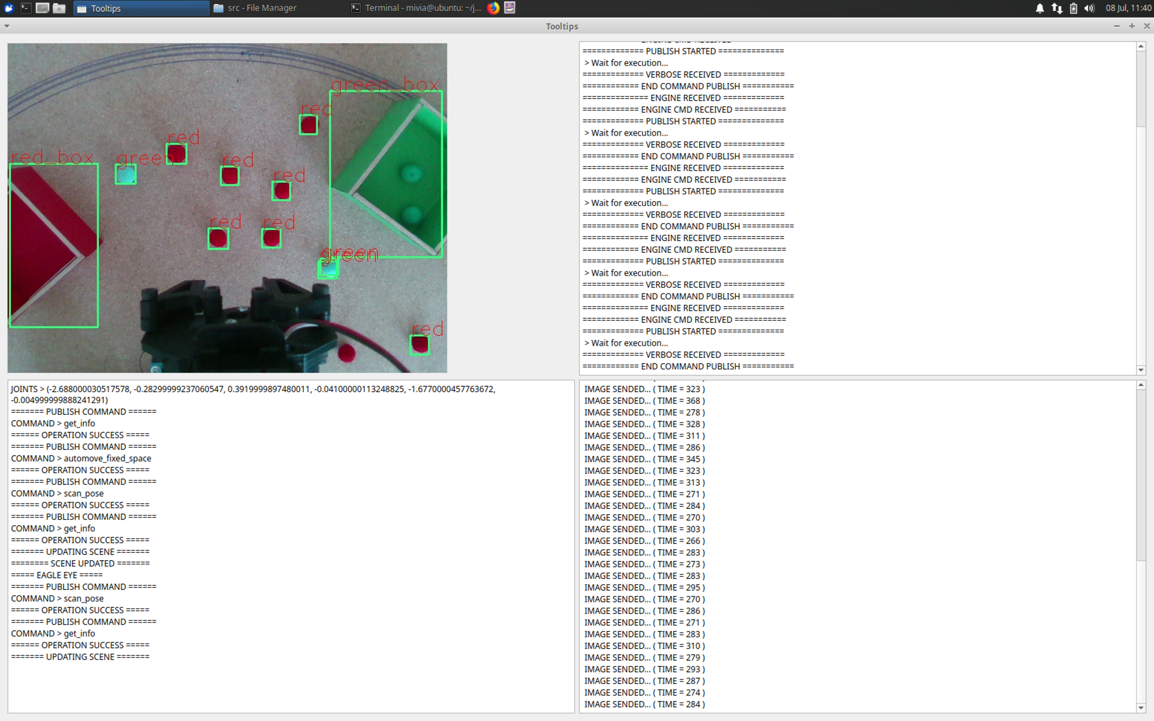
VISION NODE Look around.
MobileNet SSD v2 (COCO)
Pre-trained to detect the location of 90 types objects from COCO dataset.
Input size: 300x300
Fine tuning for 8-classes target.
DEEP NEURAL NETWORK recognition
Notes:
Screenshot ballls and boxes in eagle eye
RGB | depth

Slide 9
VISION NODE Look around.

Slide 10
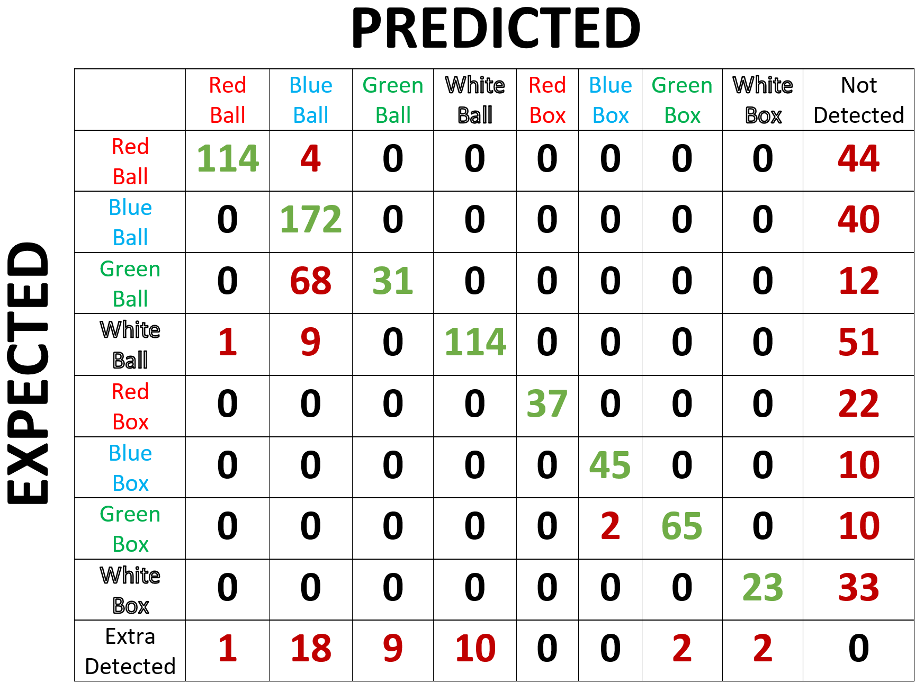
VISION NODE Look around.
DEEP NEURAL NETWORK confusion matrix
Notes:
Initialize system with calibration request
Command line interface with all the available commands of the robot
Request routines
Engine routines

Slide 11
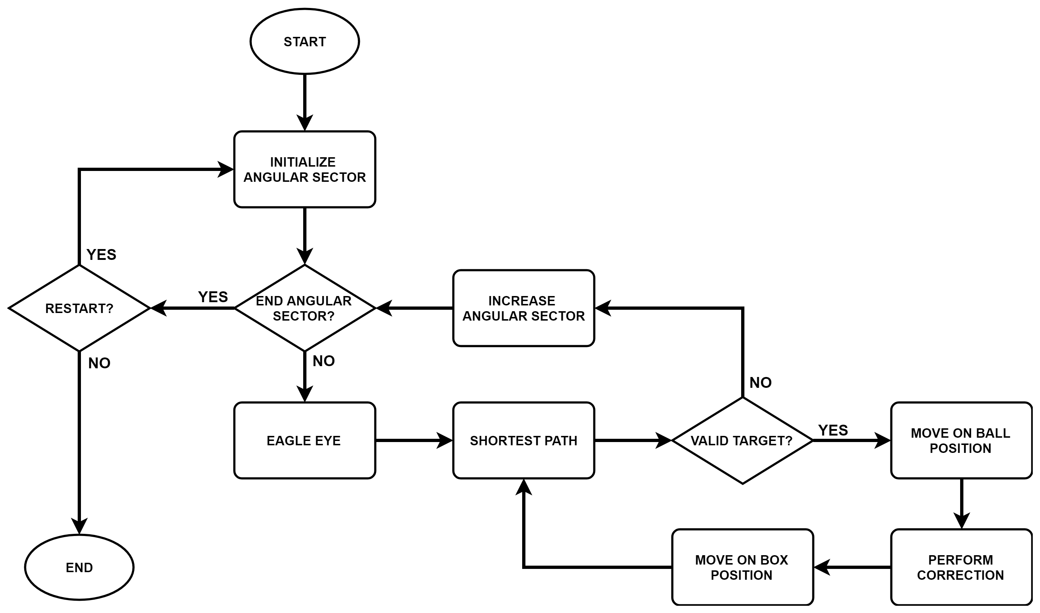
ENGINE NODE Achieve your target.
ENGINE FLOWCHART

Slide 12
VISUAL VERBOSE NODE Let me show you
what I’m doing.

Slide 13
PLANNED IMPROVEMENTS
Managing an even more dynamic workspace
Improve the recognition of targets
Speed up the use of Niryo One Python API
… and surely contemplate a new and nicer hardware structure.

Slide 14

THANKS!
OBJECT GRASPING for Cognitive Robotics
Allegretti Giovanni
Di Prisco Giovanni
Scaldaferri Antonello
Schettini Marco

